Slide 1

GOVT DOC’s GUIDE

Slide 2
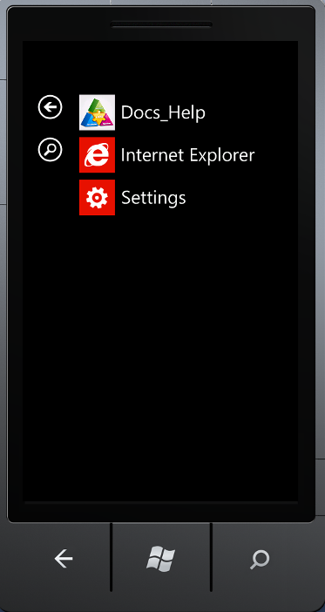
Application Shown In Menu (DOC’s HELP)

Slide 3
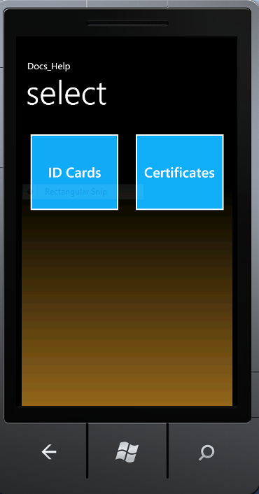
Front Page of Application

Slide 4
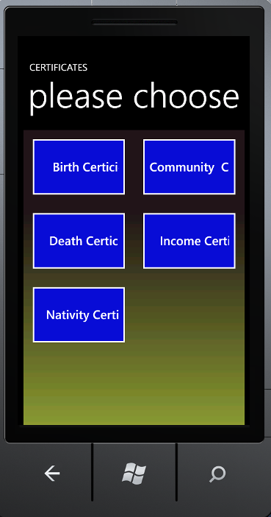
Certificates Menu has Chosen

Slide 5
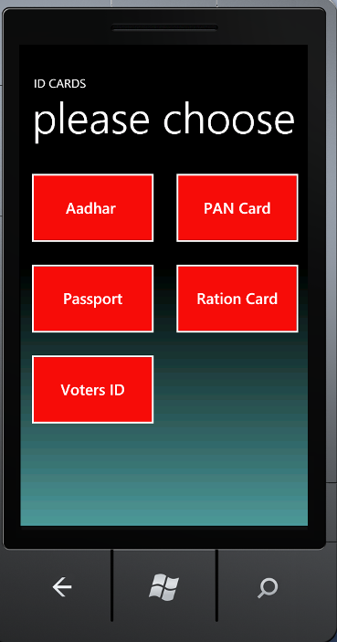
ID Card Menu has Chosen

Slide 6
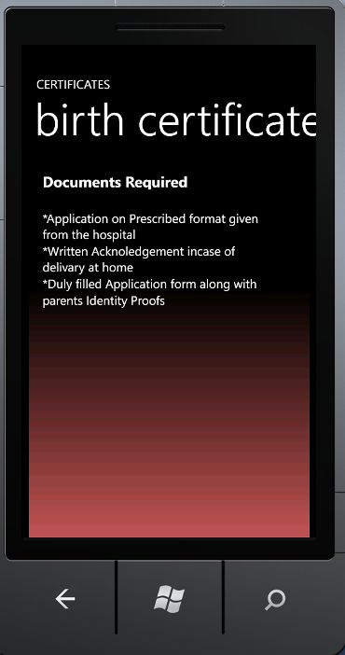
Birth Certificate Details

Slide 7
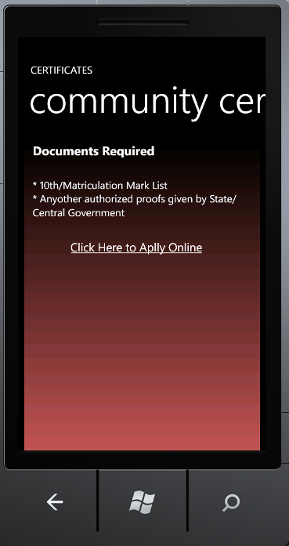
Community Certificate Details

Slide 8
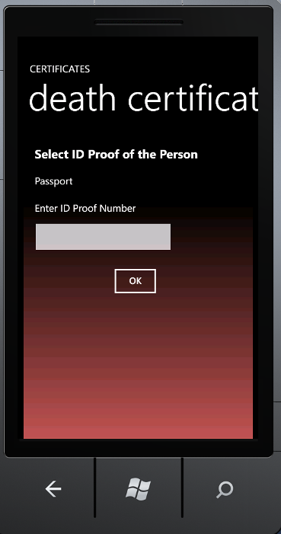
DeathCertificate Details

Slide 9
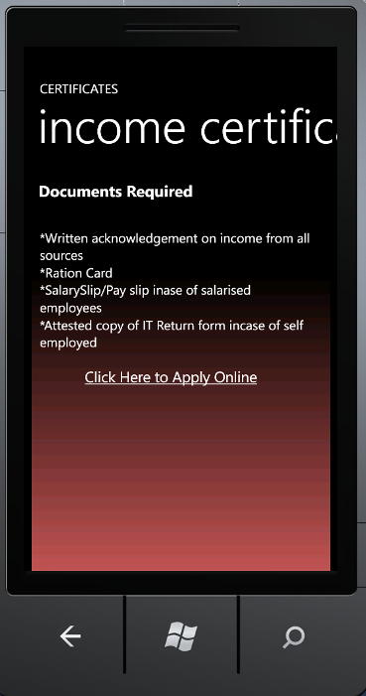
Income Certificate Details

Slide 10
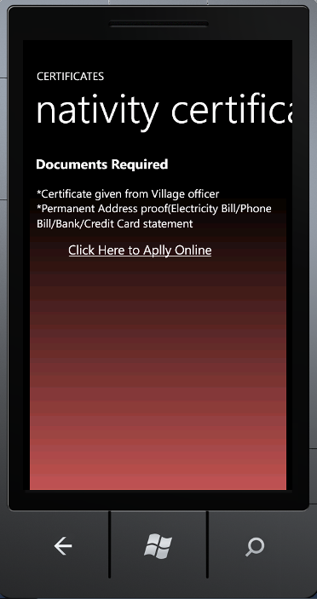
Nativity Certificate Details

Slide 11
ID Cards Menu has Chosen

Slide 12
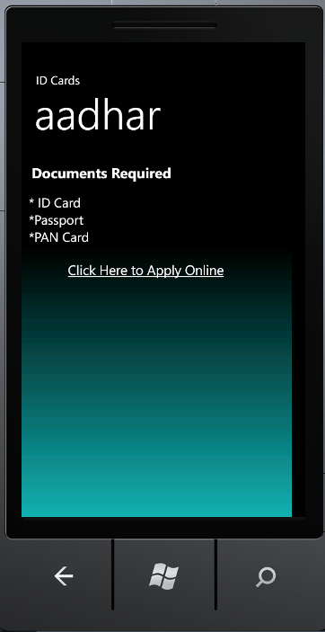
Aadhar Details

Slide 13
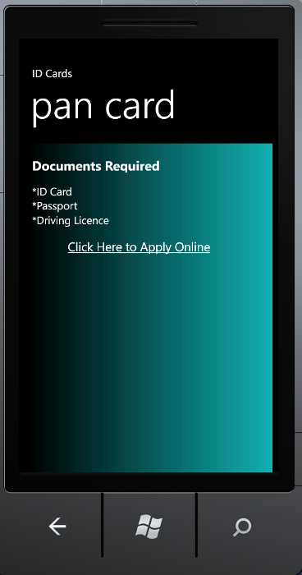
PAN Card Details

Slide 14
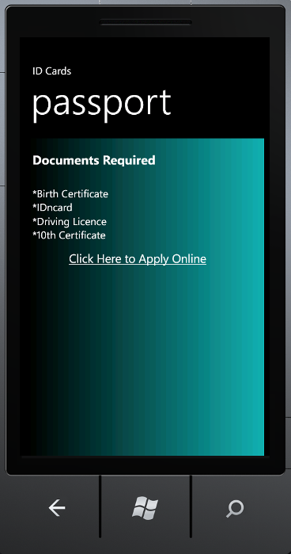
Passport Details

Slide 15
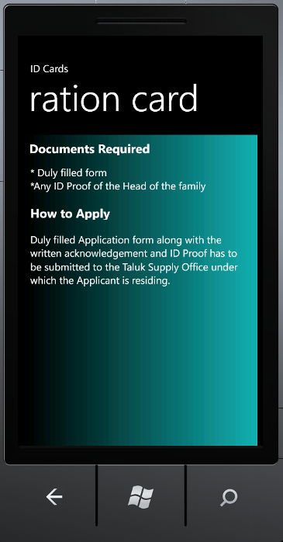
Ration Card Details

Slide 16
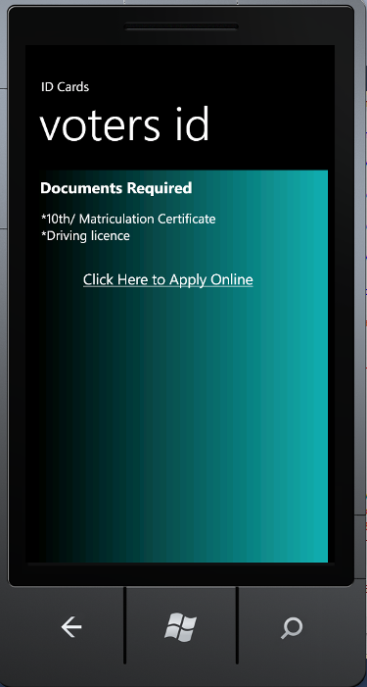
Voters ID Details

Slide 17
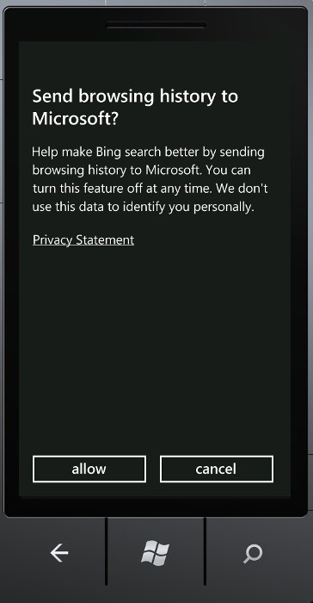
Browser Request for Navigation to Linked WebPage

Slide 18
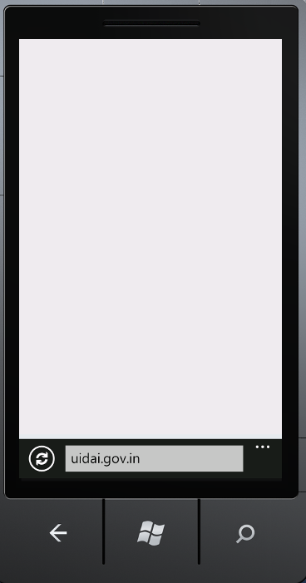
Browser Connecting to the WebPage as per User’s Requet

